Slide 1
VISUAL ANALYTICS

Slide 2
OVERVIEW
Introducing Application Area
Data Overview
Tableau Visualizations
Creating a Dashboard

Slide 3
Introducing Application Area
An insurance claim is a formal request to an insurance company asking for a payment based on the terms of the insurance policy.
The insurance company reviews the claim for its validity and then pays out to the insured or requesting party (on behalf of the insured) once approved.
Claims management is the organization, billing, filing, updating and processing of medical claims related to patient diagnoses, treatments and medications.
Claims processing is one of the most crucial service activities insurance companies perform.

Slide 4
Data Overview
The dataset contains workers compensation claims data.
The columns include Claim Identifier, TotalPaid, TotalReserves, TotalRecovery, Claim Status, Claimant Opened Date, ClaimantClosedDate, EmployerNotificationDate, Received Date, Is Denied, Claimant Type, Injury Nature, Body Part Region.
The dataset contains 25 years worth of claim management data with around 2.5 million records.

Slide 5
TASKS
1. Find the pay type for which the costs are being spent more?
2. Find the pay type for which the maximum recovery is done?
3. What are the total costs and total recoveries for each pay type and pay category?
4. In which year, was the maximum amount spent on workers?
5. In which year, was the maximum recovery done?

Slide 6
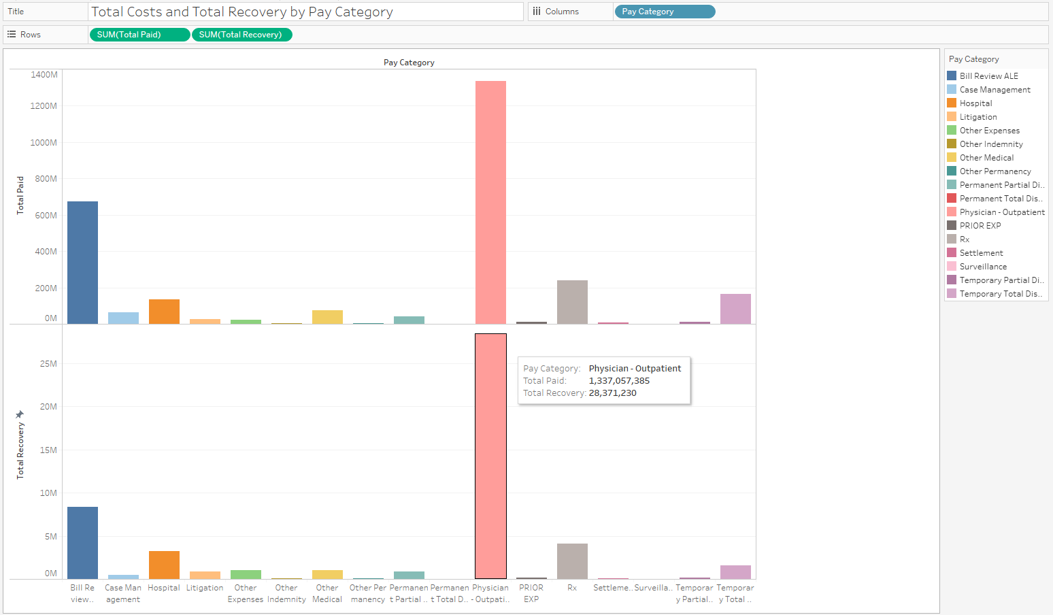
VISUALIZATIONS
This visual indicates the side by side bar comparison of total paid and total recovery of the claims data.

Slide 7
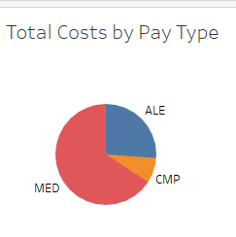
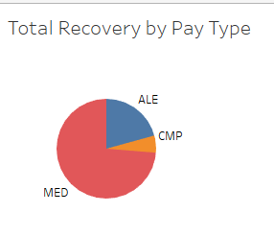
VISUALIZATIONS
These visualizations indicate the pie charts of total cost and total recovery by pay type and pay recovery.

Slide 8
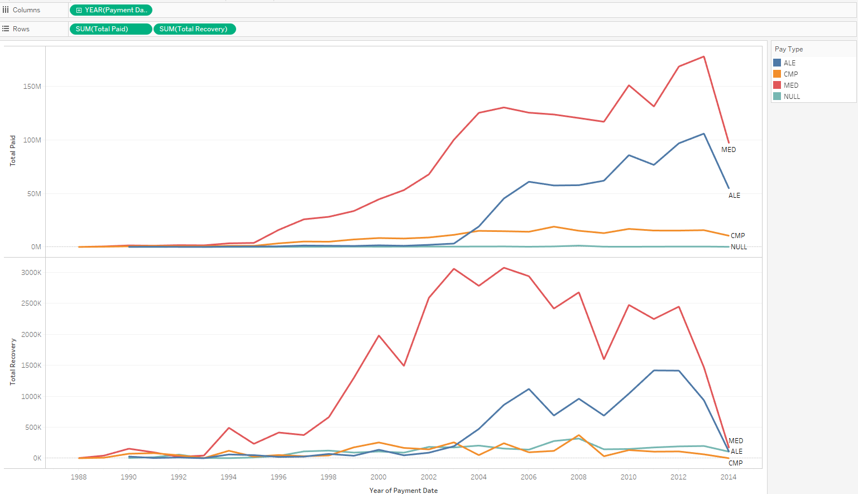
VISUALIZATIONS
This visual indicates the line chart of sum of the costs of total paid and total recovery past 25 years.

Slide 9
DASHBOARD
https://public.tableau.com/profile/bhanu.teja.sriram#!/vizhome/VisualAnalytics_16/Dashboard_VA

